Slide 1
Data Centric RAD
Bachelor of Science (Honours) in Computing in Software Development
Bachelor of Science in Computing in Software
Development
Department of Computer Science & Applied Physics

Slide 2
Lecturer Gerard Harrison
Email Gerard.Harrison@gmit.ie
Office 344A
Lecture 1 hour per week
Labs 3 hours per week

Slide 3
Marking Scheme
Open Book Assessment 1 20%
Closed Book MCQ 20%
Closed Book Written Assessment 10%
Project 50%
100% CA – No end of semester exam.

Slide 4
Introduction
Data-Centric relates to software in which data plays a crucial role.
This module will focus on
Relational Databases (MySQL)
NoSQL Databases (MongoDB)
Java Database Connectivity (JDBC)
Java Server Faces (JSF)

Slide 5
Review of MySQL
MySQL is the most popular Open Source SQL database management system, and is developed, distributed, and supported by Oracle Corporation.
A database is a collection of data…
…organized so that it can be easily accessed, managed and updated.

Slide 6
Database
A database consists of schemas, tables, views and other objects.

Slide 7
Schema
A database schema is the skeleton structure that represents the view of the entire database.
It defines how the data, and relationships between the data, is stored.
Two types of Schema:
Physical Database Schema
Refers to the actual storage of data relating to disk storage, files, indexes etc.
Logical Database Schema
Refers to the logical database, for example, the tables and the relationships between them, as well as data integrity.

Slide 8
Logical Schema
Logical Schema:
It is designed before the database is created.
No data is contained in the logical schema.
Customer Table
First Name varchar(50)
Surname varchar(50)
Address varchar(200)
PPSN varchar(10)
Credit Limit double(4,2)
PPSN Table
PPSN varchar(10)
Valid From date
Valid To date

Slide 9
Physical Schema
The Physical Schema refers to the actual storage of data in the form of files, indices, etc.

Slide 10
View
A View is a virtual table which may contain rows from one or more tables.
Views are useful for giving different perspectives on the same data.

Slide 11
DBMS
A DataBase Management System (DBMS) is software for creating and managing databases.
The DBMS interacts with the user, the database itself, and other systems in order to store, retrieve and process data.
The DBMS manages the database engine and the database schema.
An “engine” is the underlying software that the DBMS uses to access and modify data.
The default engine for MySQL is InnoDB

Slide 12
DBMS
The DBMS provides a centralized view of data that can be accessed by multiple users, from multiple locations, in a controlled manner.
The DBMS can limit what data the end user sees, as well as how that end user can view the data, providing many views of a single database schema.
The DBMS provides data independence, freeing users (and application programs) from knowing where or how the data is stored. Any changes in how or where the data is stored is completely transparent due to the DBMS.
CRUD (Create, Read, Update, Delete) functions.

Slide 13
DBMS
A DBMS deals with:
Data Storage Management
Security
Backup and Recovery
Transaction Management
Data Integrity
Concurrency

Slide 14
Advantages of DBMSs
Controlling Redundancy
Instead of each application having its own files with data stored multiple times, a centralised DBMS can store it once and allow many users to access it eliminating duplication.
Data Integrity
If the DB is setup correctly incorrect info can’t be stored. E.g. Deleting a student from a DB should mean he is removed from all courses he is doing also.
Enforcement of Standards
As data is stored centrally, company standards can be enforced. E.g. Date format.
Backup and Recovery
A DBMS provides backup and recovery e.g. ACID transactions, ensuring the DB is always consistent.
Security
Users should be granted access to only those data and reports which they specifically need. It restricts users from viewing or updating data which is not in their scope.

Slide 15
Disadvantages of DBMSs
Complexity
Providing all the features mentioned means additional complexity. Developers and end-users must understand at least some of it to take full advantage of the DB.
Size
The Complexity means a DBMS is a very large piece of software both in terms of memory and disk space.
Cost
DBMSs are expensive.
Performance
An application written for a specific purpose e.g. accounts is likely to be faster than a general-purpose DBMS.
Higher impact of failure
Because all users use the centralised database any failure, or downtime can be catastrophic.

Slide 16
Types of Databases
Hierarchical
Network
Object Oriented
Relational
MySQL will be the database we will use.
NoSQL
MongoDB will be the database we will use.

Slide 17
Review of MySQL
Tables store data in MySQL.
Tables are uniquely named.
Tables generally store data about a specific object e.g. an Employee, a Student, a Customer.
If the table has a Primary Key then each row in the table is unique.
A Primary Key must be unique and cannot be NULL.

Slide 18
Review of MySQL
Superhero Table
Name | City | Real First Name | Real Surname
Spiderman | New York | Peter | Parker
Superman | Metropolis | Clark | Kent
Batman | Gotham City | Bruce | Wayne
✓
Joker | Metropolis | Clark | Kent
✓
Superman | Metropolis | Clark | Kent
There are repeating rows in this table, so data is
inconsistent.
Need to apply a Primary Key.
Primary Keys must be unique and non NULL.

Slide 19
Review of MySQL
To make our data more useful, apply a Primary Key constraint to the table.
We can only have one Superhero of a given name.
What would the Primary Key be?
Superhero Table
Name | City | Real First Name | Real Surname
Spiderman | New York | Peter | Parker
Superman | Metropolis | Clark | Kent
Batman | Gotham City | Bruce | Wayne
*
✗
Superman | Dublin | Sean | O’Malley
✓
Joker | Metropolis | Clark | Kent

Slide 20
Review of MySQL
We can only have one Superhero per City.
What would the Primary Key be?
Superhero Table
Name | City | Real First Name | Real Surname
Spiderman | New York | Peter | Parker
Superman | Metropolis | Clark | Kent
Batman | Gotham City | Bruce | Wayne
*
✓
Superman | Dublin | Sean | O’Malley
✗
Joker | Metropolis | Clark | Kent

Slide 21
Review of MySQL
We can have many unique Superheroes per city.
What would the Primary Key be?
Superhero Table
Name | City | Real First Name | Real Surname
Spiderman | New York | Peter | Parker
Superman | Metropolis | Clark | Kent
Batman | Gotham City | Bruce | Wayne
*
*
✓
Spiderman | Metropolis | Bruce | Clark
✓
Batman | Metropolis | Bruce | Wayne
✗
Spiderman | New York | Bill | Smith

Slide 22
Review of MySQL
List all databases:
show databases;
Use a particular database, e.g. the employees database:
use employees;
List all tables in a database:
show tables;

Slide 23
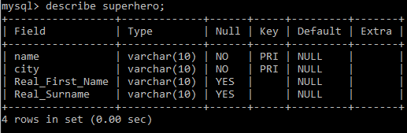
Review of MySQL
Show the structure of a table, e.g. the superhero table (Note: this returns meta data (columns), not rows):
describe superhero;
Superhero Table
Name | City | Real First Name | Real Surname
Spiderman | New York | Peter | Parker
Superman | Metropolis | Clark | Kent
Batman | Gotham City | Bruce | Wayne

Slide 24
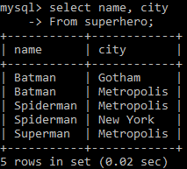
Review of MySQL
Select is used to query the database and get data (rows).
Select <columns>
From <table>;

Slide 25
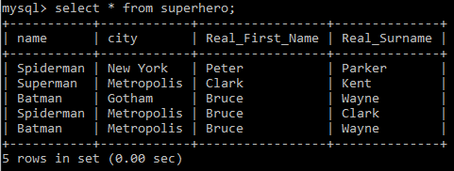
Review of MySQL
Select <column1>
Selects column1
Select <column1, column2>
Selects column1 and column2
Select *
Selects all columns

Slide 26
Review of MySQL
Column Aliases.
We may want to use different/abbreviated column names in our MySQL statements – ones that are different from the column names in the database.
Select <column> as <alias>
Selects <column> but renames it <alias>

Slide 27
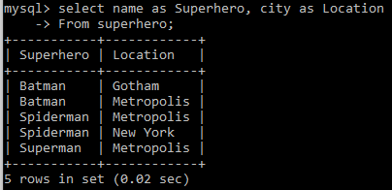
Review of MySQL
In our code we want to refer to name as Superhero, and city as Location. How?

Slide 28
Review of MySQL
Oftentimes, we’ll want to limit our Select to certain records.
This is done using the Where clause.

Slide 29
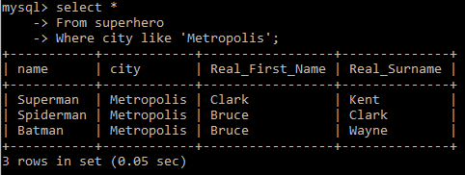
Review of MySQL
Only want to return the Superheroes who live in Metropolis. How?

Slide 30
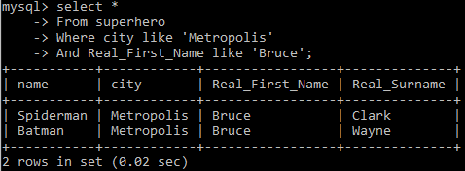
Review of MySQL
Where clause can be complex depending on the columns being filtered.
Only want to return the Superheroes whose first name is ‘Bruce’ and who live in Metropolis. How?

Slide 31
Review of MySQL
Where operators:
= Equal To
<> Not Equal To
!= Not Equal To
> Greater Than
< Less Than
>= Greater Than or Equal To
<= Less Than or Equal To
BETWEEN Between an inclusive range
LIKE Search for a pattern
IN Result is one of multiple specified values

Slide 32
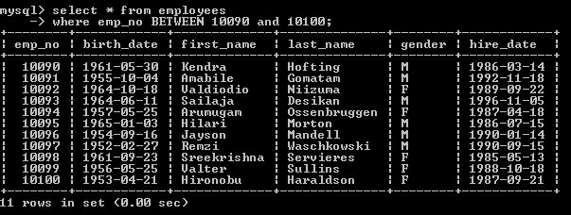
Review of MySQL
BETWEEN

Slide 33
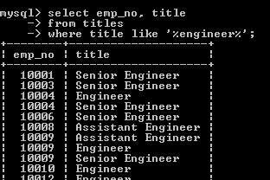
Review of MySQL
LIKE
% represents 0 or more characters

Slide 34
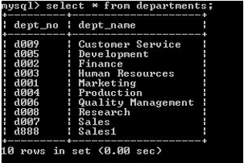
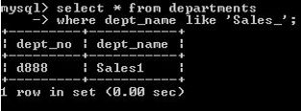
Review of MySQL
LIKE
_ represents a single character
How to show only ‘Sales1’ department?

Slide 35
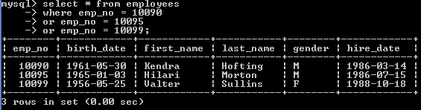
Review of MySQL
IN
Used to replace many “OR” Conditions
Get details of the employees with the following emp_nos: 10090, 10095 and 10099.

Slide 36
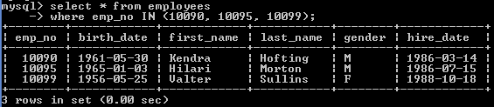
Review of MySQL
IN
Used to replace many “OR” Conditions
Get details of the employees with the following emp_nos: 10090, 10095 and 10099.

